Slide 1
Image and Video Analysis
Digital Humanities

Slide 2
Definition
Image and video analysis is the extraction of meaningful information from images and video.
We typically think of this as mainly a digital process. Digital image processing techniques are certainly used, but there is an important analog component to the field as well.
Image analysis tasks can be as simple as reading bar coded tags or as sophisticated as identifying a person from their face.
We also need to consider the original image. Was it born digital or analog?

Slide 3
Understanding Images
Today, we will look at three examples to get a better understanding of image analysis.
Image analysis techniques – Leonardo da Vinci
Case study – the Lowell Thomas Papers
Practical applications – Image Processing

Slide 4
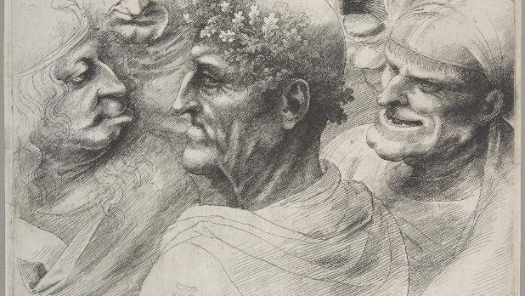
Image Analysis Techniques
The Search for the True Face of Leonardo by Siegfried Woldhek
https://www.ted.com/talks/siegfried_woldhek_shows_how_he_found_the_true_face_of_leonardo

Slide 5
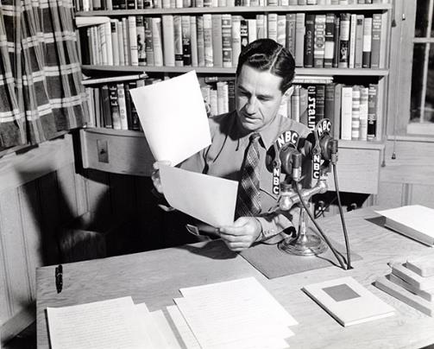
Case Study – The Lowell Thomas Papers

Slide 6
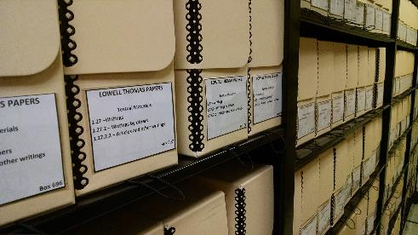
The Lowell Thomas Papers
Who was Lowell Thomas?
Overview of Thomas
Overview of his papers
Improving access to the collections through:
Digital surrogates
3D imaging
Augmented reality
In-class instruction

Slide 7
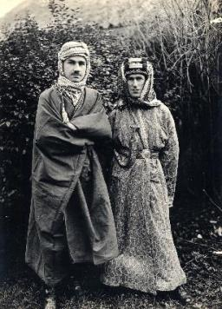
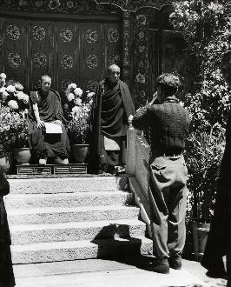
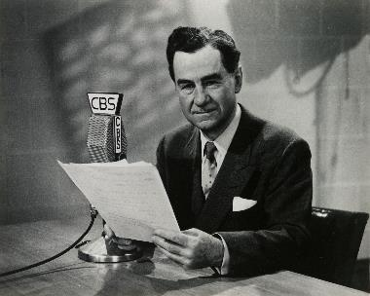
Who was Lowell Thomas?
Lowell Jackson Thomas (1892-1981) became a household name as a newsman, writer, lecturer, explorer, and entrepreneur.
Thomas broadcasting the news,
circa 1960
Thomas and T.E. Lawrence, 1918
Thomas photographing the Dalai Lama
in Lhasa, 1949

Slide 8
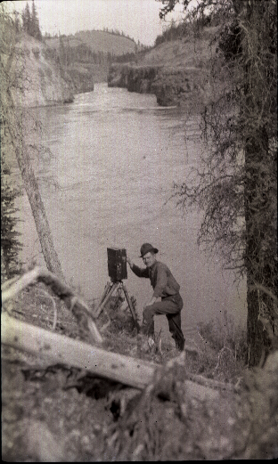
Thomas capturing film footage for Alaska travelogue, 1915

Slide 9
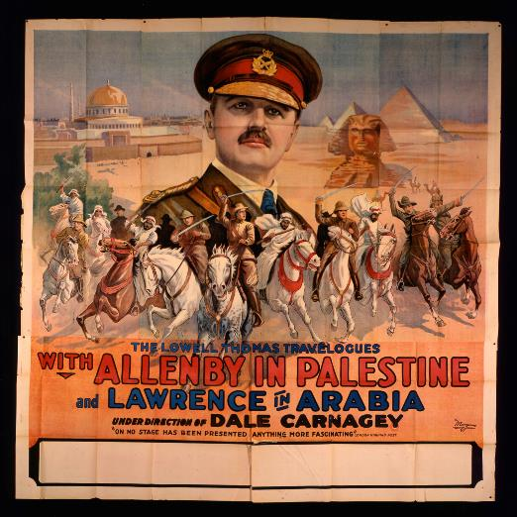
Lowell Thomas Travelogue poster, 1920

Slide 10
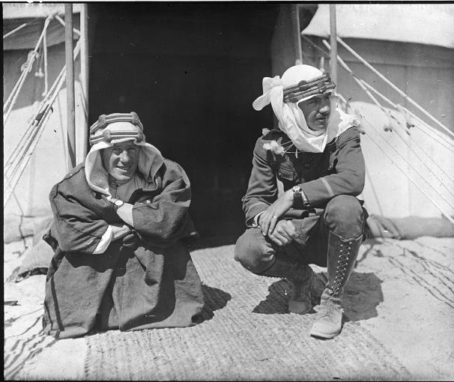
T. E. Lawrence and Lowell Thomas, 1919

Slide 11
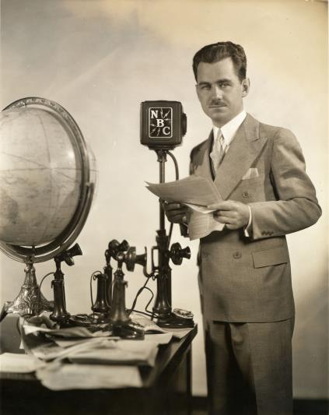
Lowell Thomas launches his radio news program, September 29, 1930

Slide 12
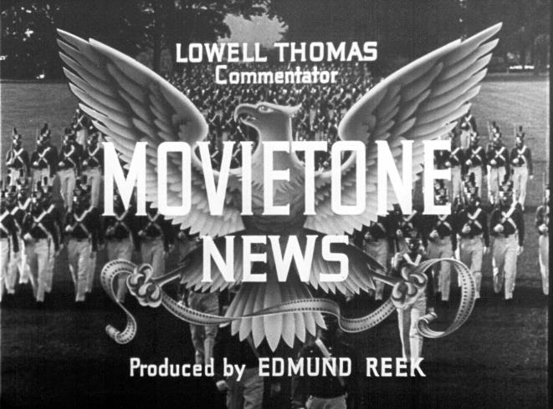
Fox Movietone News with Lowell Thomas, 1930s

Slide 13
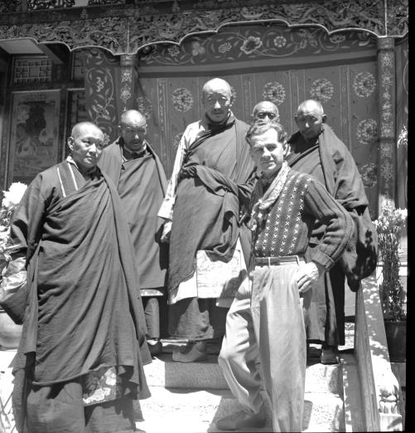
Thomas in Tibet, 1949

Slide 14
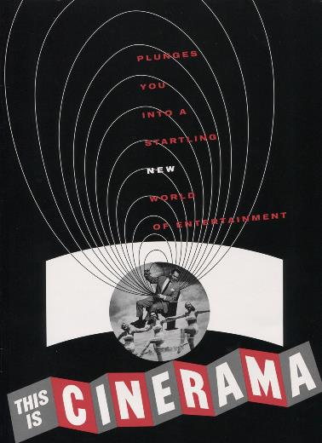
“This is Cinerama” program, 1952

Slide 15
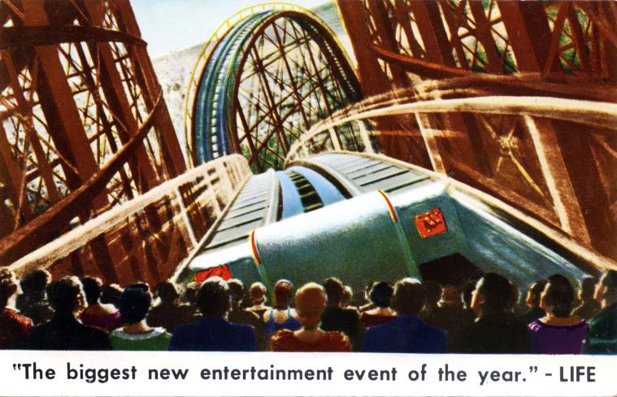
Cinerama postcard, 1952

Slide 16
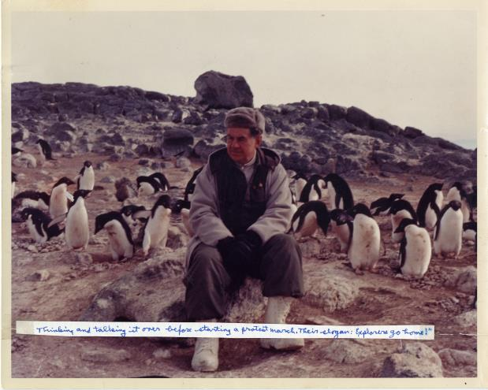
Thomas on location in Antarctic for High Adventure, 1957

Slide 17
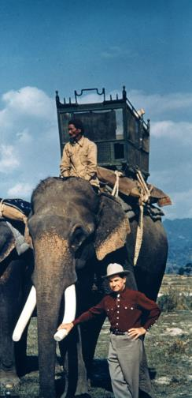
Thomas on location in India for High Adventure television episode, 1958

Slide 18
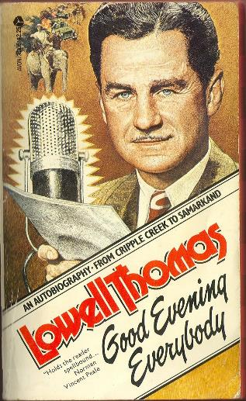
Cover of paperback edition of So Long Until Tomorrow, 1976

Slide 19
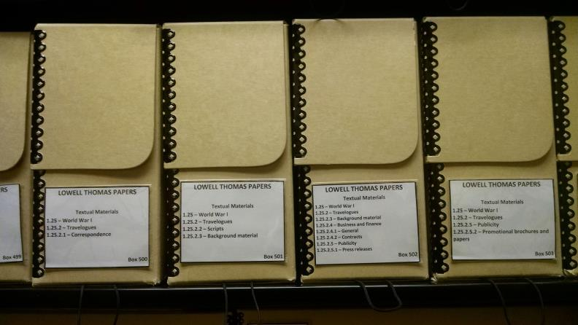
Provenance of the Lowell Thomas Papers

Slide 20
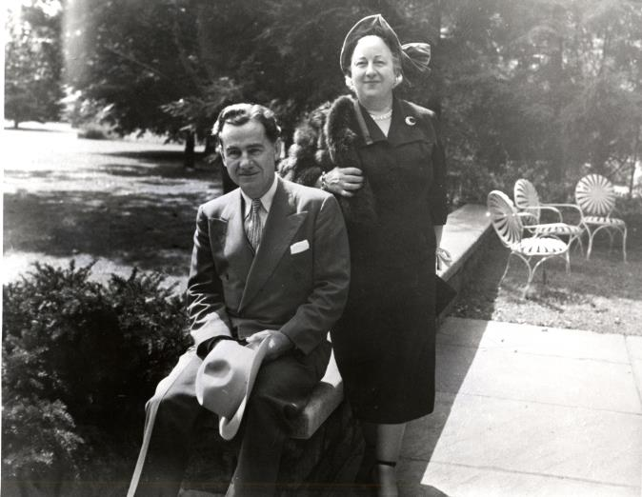
Lowell with his wife Fran Thomas at home in Pawling, 1962

Slide 21
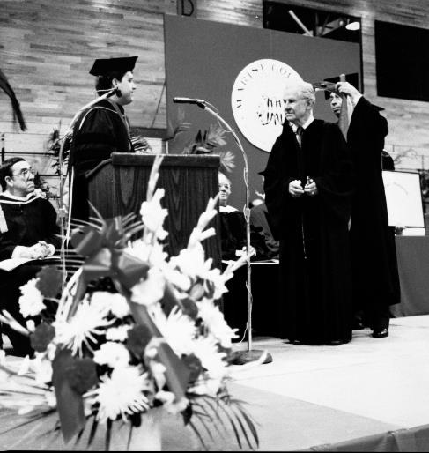
Thomas at Marist Commencement, 1981

Slide 22
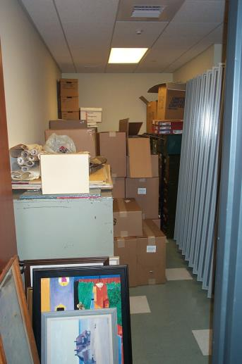
Marist Archives & Special Collections stacks, 2000

Slide 23
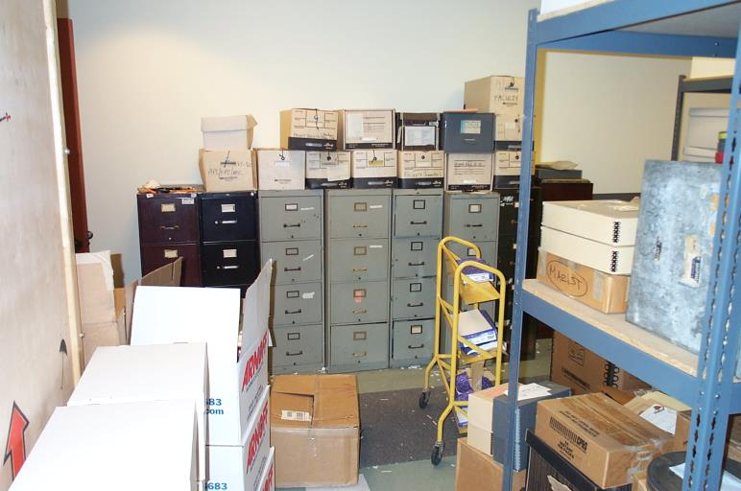
Marist Archives & Special Collections stacks, 2000

Slide 24
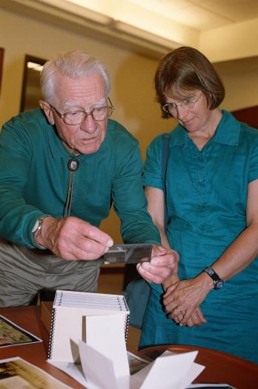
Lowell Thomas, Jr. with daughter Anne Donaghy, 2006

Slide 25
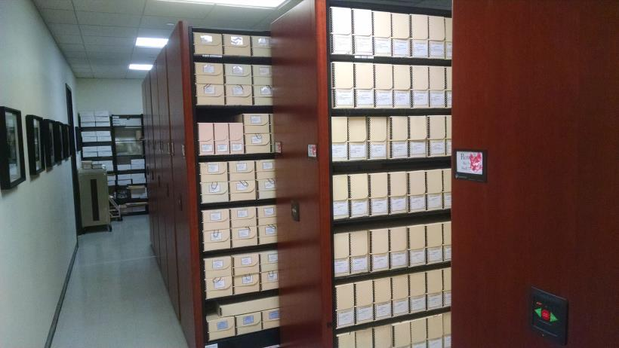
Marist stacks after renovations, 2013

Slide 26
NHPRC Grant Project 2011
Lowell Thomas Digitization Project funded by National Historical Publications and Records Commission (NHPRC).

Slide 27
Two major goals:
Digitization of 39,000 graphic materials.
Make them accessible online.

Slide 28
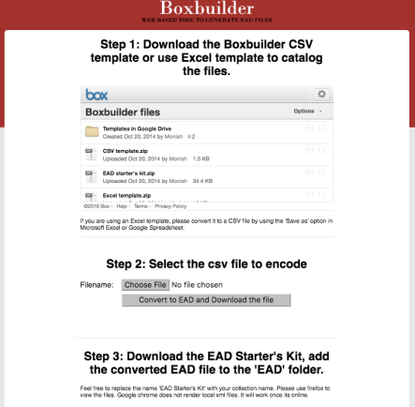
Boxbuilder http://library.marist.edu/boxbuilder

Slide 29
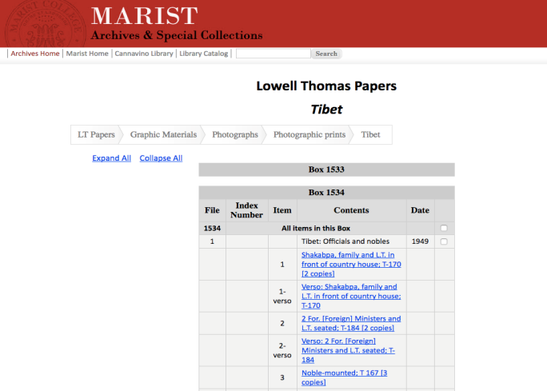
EAD web pages

Slide 30
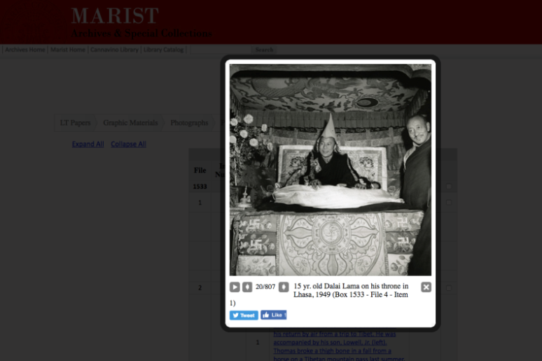
EAD web pages

Slide 31
Next Challenge: How to make EAD web pages discoverable ?

Slide 32
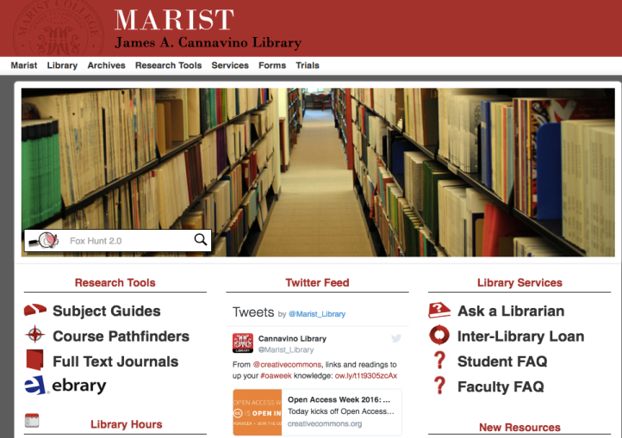
Fox Hunt

Slide 33
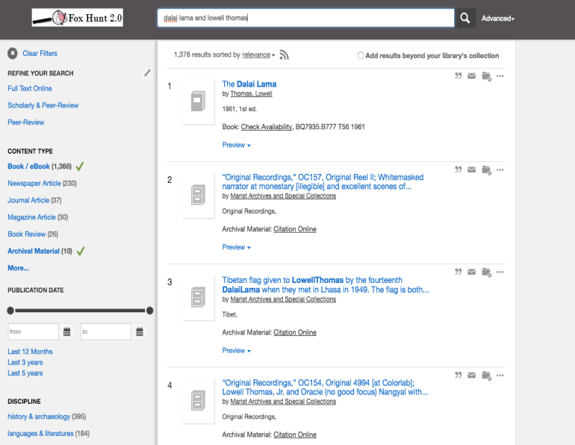

Slide 34
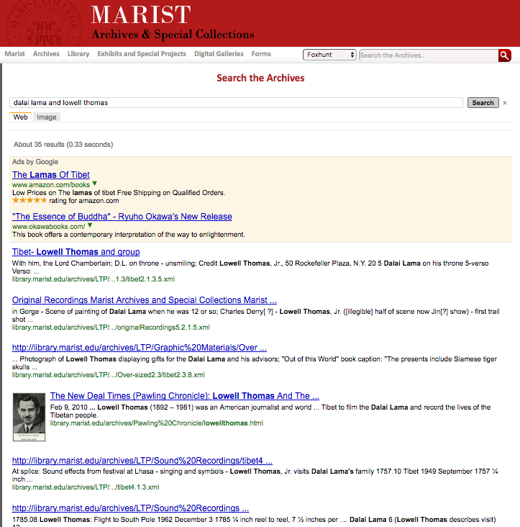

Slide 35
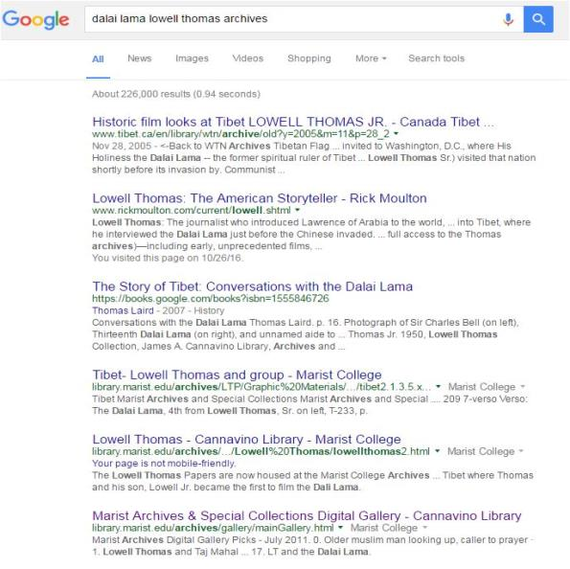

Slide 36
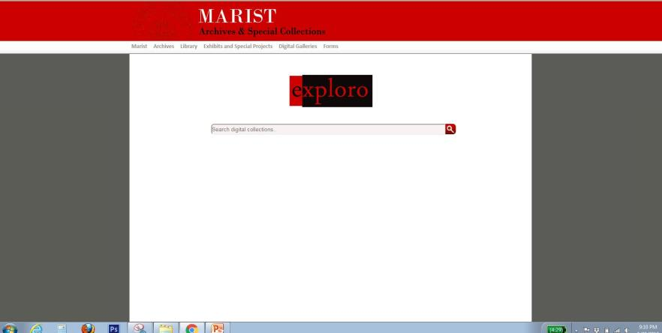
Exploro – Finding Digital Surrogates

Slide 37
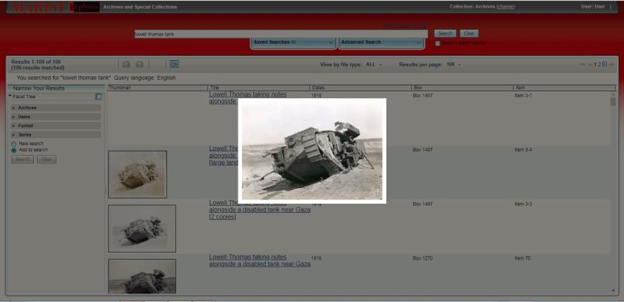
Exploro – Finding Digital Surrogates

Slide 38
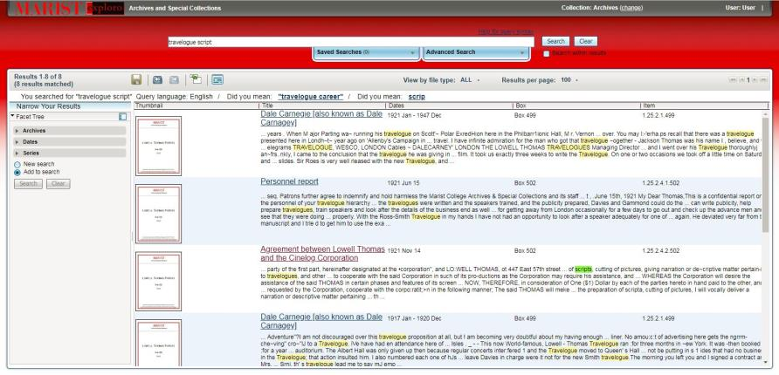
Exploro – Finding Digital Surrogates

Slide 39
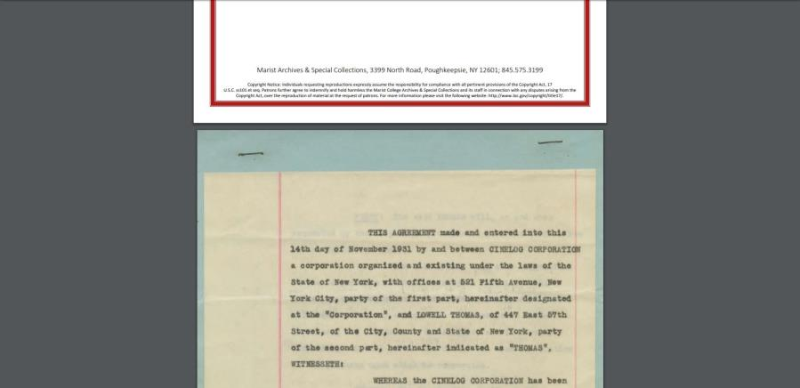
Exploro – Finding Digital Surrogates

Slide 40
Social media: An effective platform for engagement
Facebook: 1,432 likes
Twitter: 865 followers
Pinterest: 83 followers

Slide 41
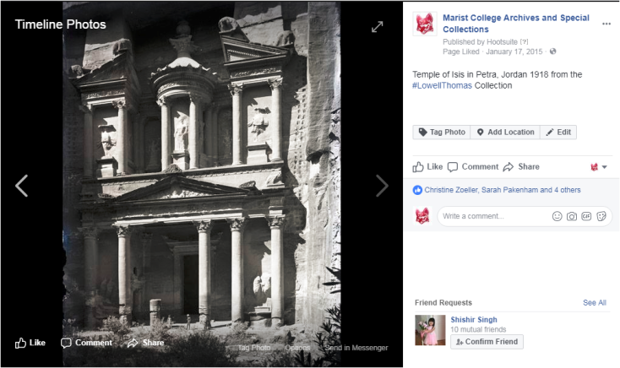

Slide 42
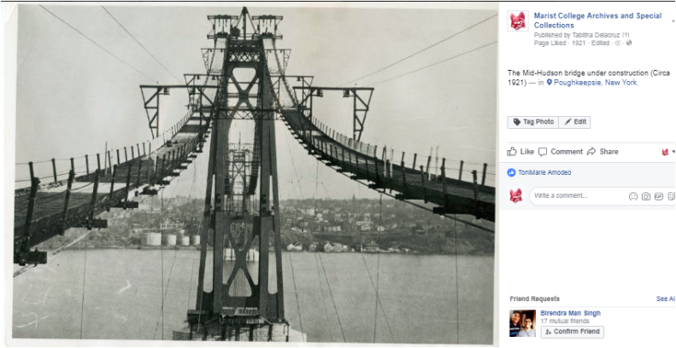

Slide 43
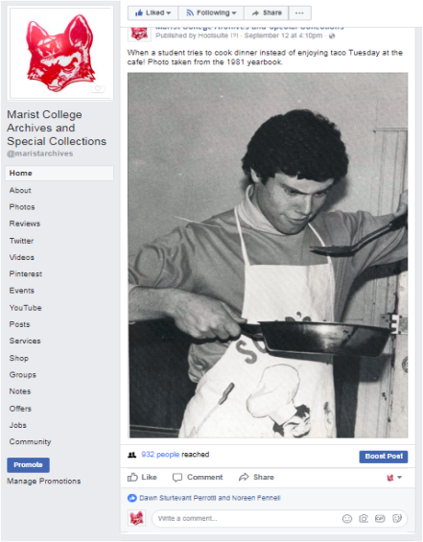

Slide 44
1. Digitized over 2,500 textual materials. 2. Digitized over 100 objects.

Slide 45
Challenges of 3D modeling
Lack of standard workflows and tools.
Complex operation that requires diverse set of hardware and software technologies.
Training staff or outsourcing adds a significant overhead.
Steep learning curve.

Slide 46
jQuery Reel
Open source three-sixty player free to use under MIT License.
http://jquery.vostrel.cz/reel

Slide 47
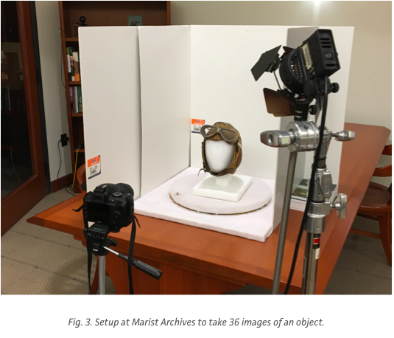

Slide 48
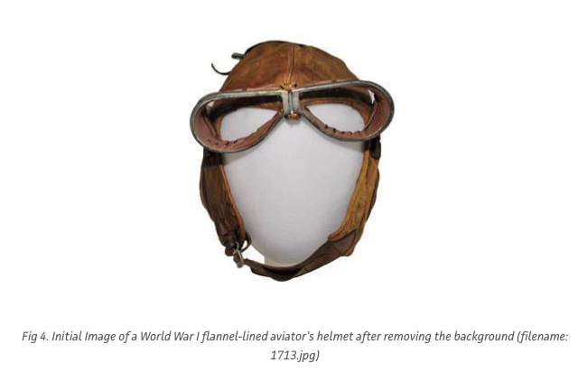

Slide 49
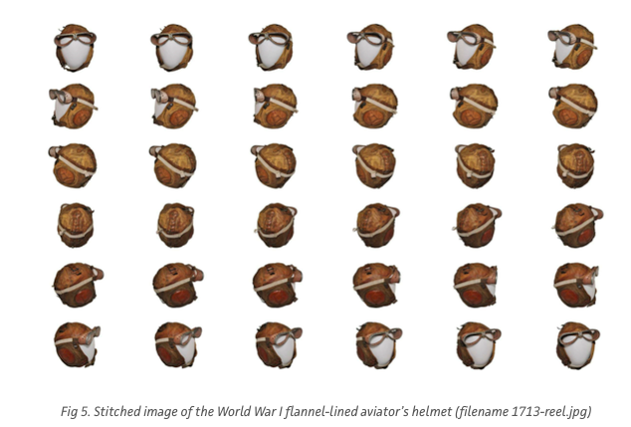

Slide 50
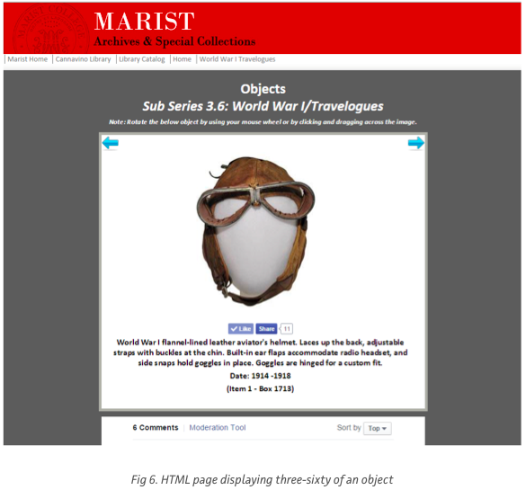
http://library.marist.edu/archives/LTP/Objects/objects360/1713.1.htm

Slide 51
Singh, Monish. “Creating Three-Sixty Objects For Marist Archives Using Open Source JQuery Reel.” Practical Technology for Archives. https://practicaltechnologyforarchives.org/issue5_singh/ Monish is the Digital Services Librarian for the Marist College Library. monish.singh@marist.edu

Slide 52
Augmented Reality
Augmented reality platform to better engage users and create an immersive, multi-sensory experience.
HP Reveal - https://www.hpreveal.com/
HP Reveal demo

Slide 53
Future Challenges
The multi-media nature of the collection poses long-term preservation challenges.
Migrating to a new discovery system to provide better access to audio and video formats.

Slide 54
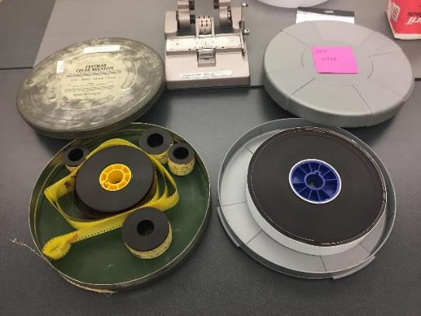
Lowell Thomas Film Project

Slide 55
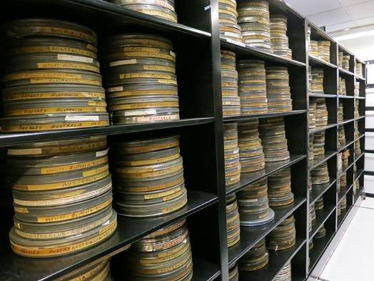
Lowell Thomas Film Project

Slide 56
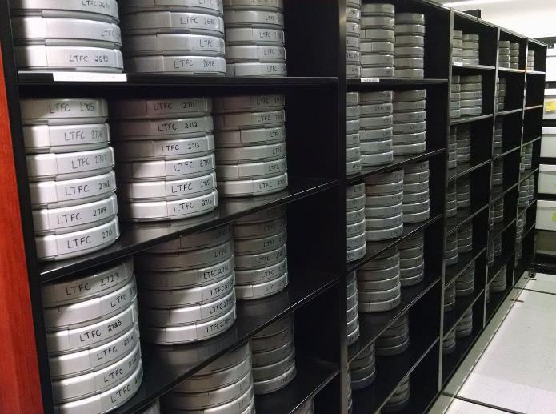
Lowell Thomas Film Project

Slide 57
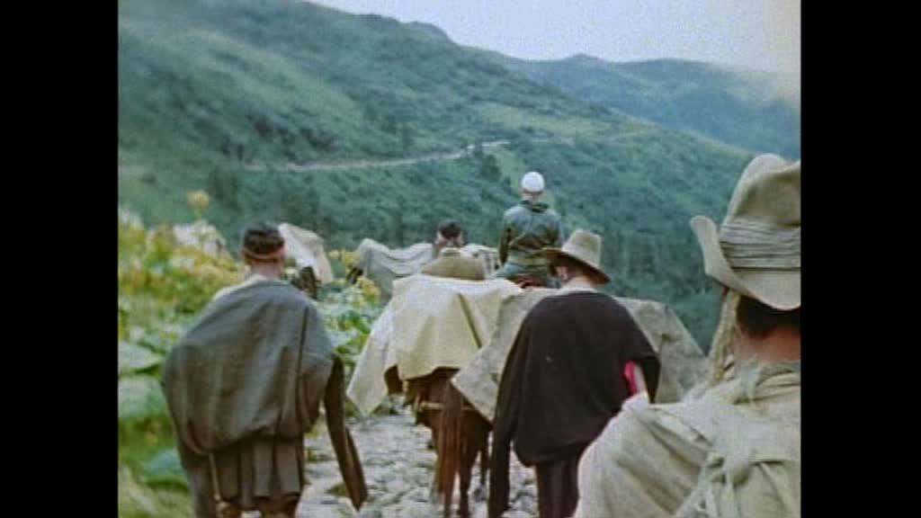
Lowell Thomas Film Project

Slide 58
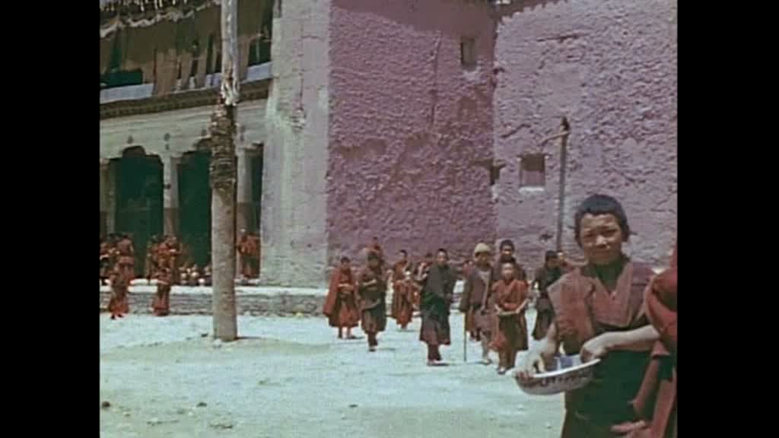
Lowell Thomas Film Project

Slide 59
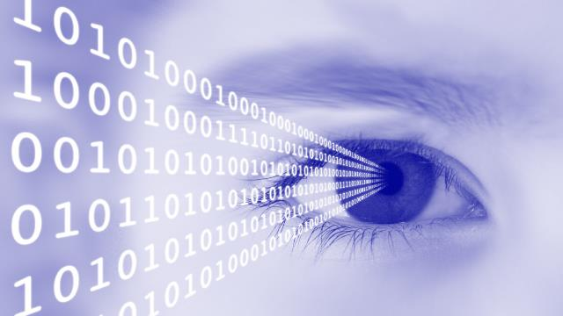
Practical Applications
What is Image Processing? Vision Campus
https://www.youtube.com/watch?v=QMLbTEQJCaI

Slide 60
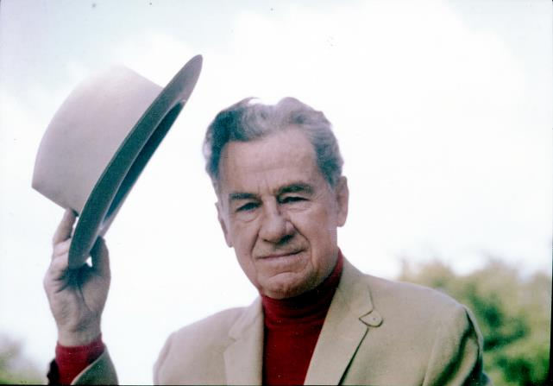
Have a good weekend!

